Slide 1
Small Cell Wireless Update

Slide 2
Background
Wireless communications companies are rolling out small cell wireless installations to address coverage gaps and improve service to customers.
State statutes and FCC rulings require that Cities allow wireless companies to install these facilities in the public right-of-way, subject to reasonable conditions or restrictions.

Slide 3
Background for Richfield
Two companies (AT&T and Verizon) have applied for small cell wireless permits in Richfield.
Co-location agreements that allow wireless companies to mount equipment on City-owned light poles are in place for both companies.

Slide 4
Small Cell Status – AT&T
10 permits approved in 2019
All 10 permits are for co-location (no stand-alone)
Two constructed, but are not yet operational
66th Street and Lyndale Avenue
66th Street and Nicollet Avenue

Slide 5
Small Cell Status – Verizon
17 permits submitted in 2020
8 are approved; 7 under review
2 applications were rescinded by Verizon due to City staff concerns about locations.
All locations are stand-alone poles that will be owned by Verizon.

Slide 6
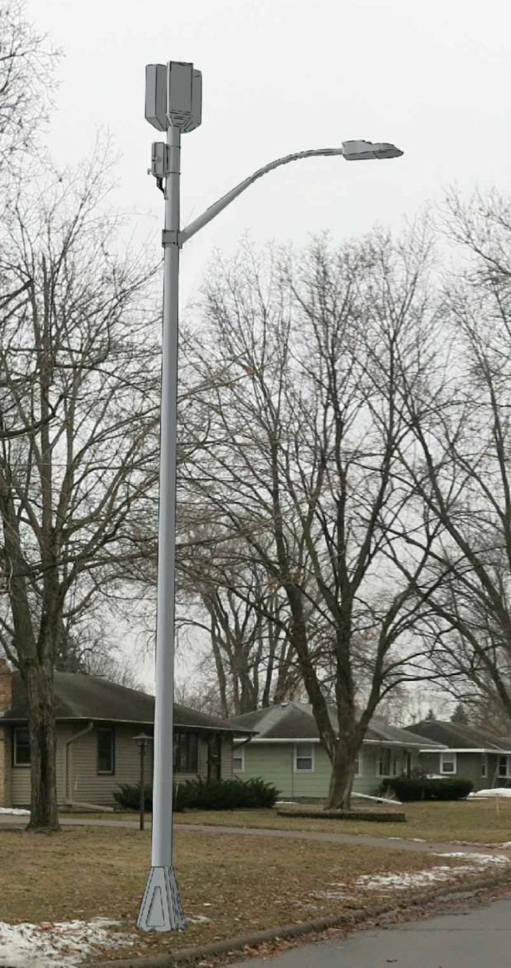
Small Cell Outlook
COVID-19 appears to be impacting the short-term outlook for applications and possibly construction of new facilities.
AT&T has indicated they will be applying for one additional location this year, although more are possible.
Verizon has indicated they will be applying for up to five additional locations this year.
All Verizon applications starting in 2021 will be co-located on City poles where possible.

Slide 7
Location visualization
The map provided to Council shows the locations and status of applications/ permits for both AT&T and Verizon.
Staff is developing an interactive map of small cell installations that will be used for permit and construction tracking and could be made public if the Council desires.
Notes:
Will share separate screen during presentation. Map here: ‪R:\Administration\Small Cell Wireless\SmallCellWirelessMap.pdf

Slide 8
City Code Modifications
Limited authority
Current:
Conditional Use Permit required in residential
Vague screening and separation language
Proposed:
Remove ineffective CUP
Replace with aesthetic and spacing guidelines that apply in all districts.

Slide 9
Proposed Regulations
Canisters/shrouds
Placement on poles
Coloring
150-ft spacing
Locate on property lines
Ground mounted equipment standards
Lighting & signage prohibited

Slide 10
Questions?
Thank you!

